Slide 1


Obada Daghlas
PISA 2022 Data Analysis
Understanding Global Student Performance

Slide 2
Introduction
Programme for International Student Assessment (PISA)
International assessment evaluating education systems worldwide
Tests skills and knowledge of 15-year-old students
2022 assessment covered ~600,000 students across participating countries
Focus Areas
Country-level differences in academic achievement
Gender gaps across different subject domains
Impact of socioeconomic status on performance
Relationship between school climate and academic outcomes

Slide 3
Research Questions
Which countries demonstrate the highest performance across different subject areas?
How do male and female students perform differently across the three core PISA domains?
Which countries demonstrate the strongest link between socioeconomic status and academic performance?
What is the relationship between a country's average socioeconomic status and its mathematics performance?

Slide 4


Methodology
Data Preparation
Cleaning, optimization, and transformation of raw PISA dataset
Exploratory Data Analysis
Investigation of distributions, relationships, and patterns
In-depth Analysis
Focused examination of key research questions
Visualization
Creation of insightful visualizations to communicate findings

Slide 5
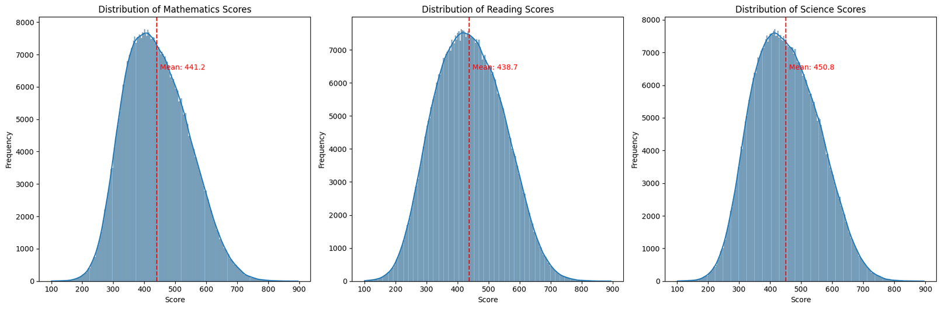
Performance Distributions
Analysis of student performance across mathematics, reading, and science

Slide 6
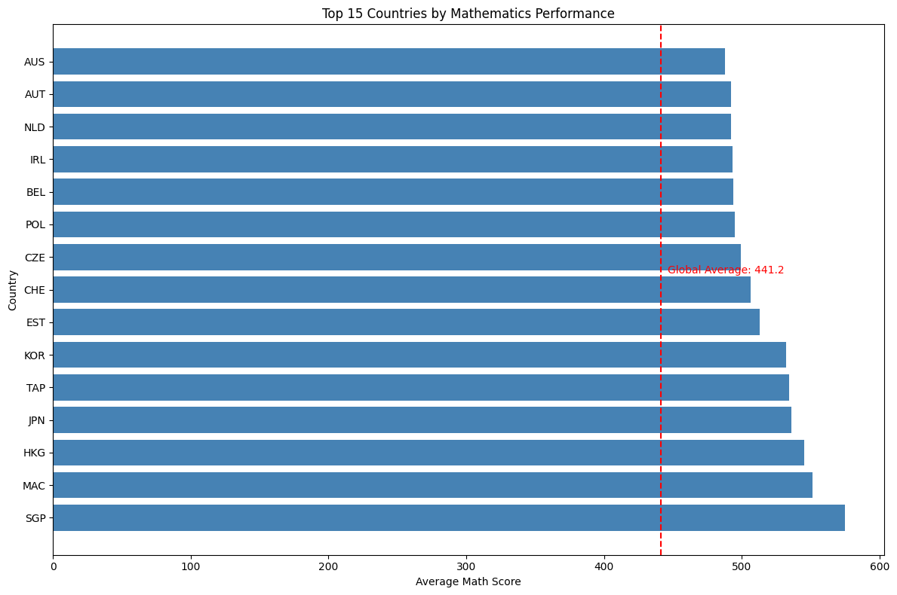
Top Performing Countries
Key Observations:
East Asian education systems (Singapore, Macau , Hongkong, Japan) lead in mathematics
Estonia and Finland demonstrate balanced excellence across all domains
Regional patterns show distinct educational priorities

Slide 7
Top Performing Countries
Key Observations:
East Asian education systems (Singapore, Macau , Hongkong, Japan) lead in mathematics
Estonia and Finland demonstrate balanced excellence across all domains
Regional patterns show distinct educational priorities

Slide 8
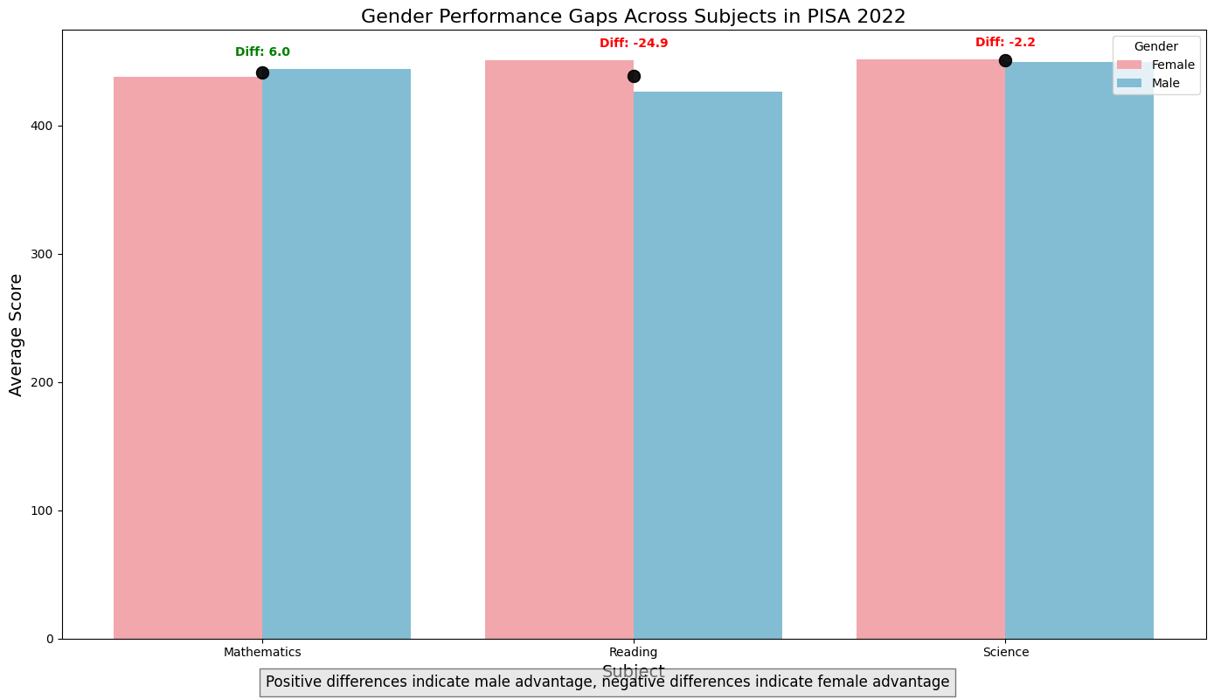
Gender Differences
Key Findings:
Girls outperform boys in reading by ~30 points (approximately one year of schooling)
Boys maintain a small advantage in mathematics (~5 points globally)
Science performance is nearly equal between genders
Gender gap magnitude varies significantly across countries

Slide 9
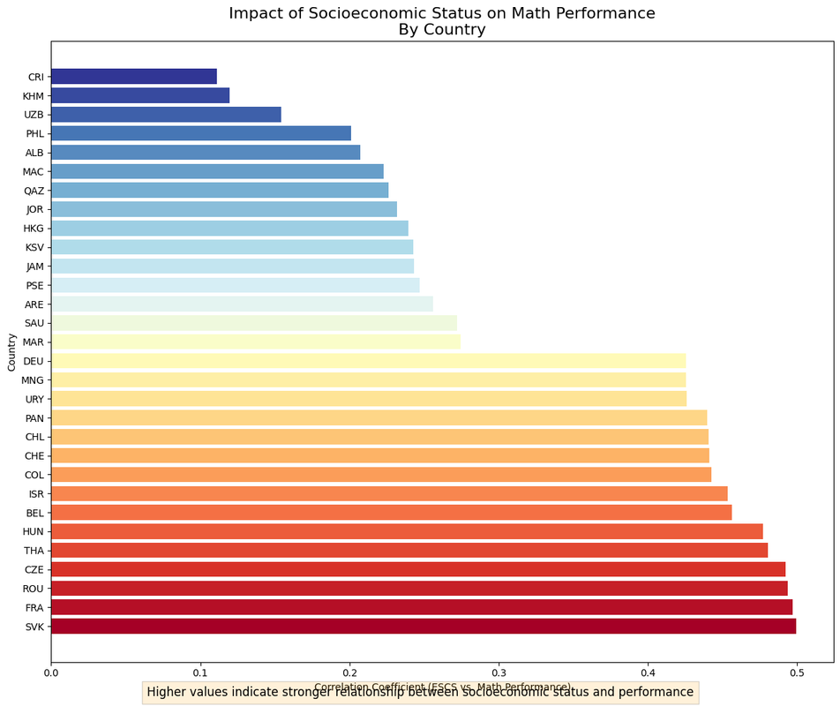
ESCS-Performance Relationship
Educational Inequality:
Highest in Hungary, Luxembourg, and several Latin American countries (correlations > 0.40)
Lowest in East Asian systems like Hong Kong and Macao, and Estonia (correlations < 0.25)
Some countries combine high performance with relatively low impact of socioeconomic status

Slide 10
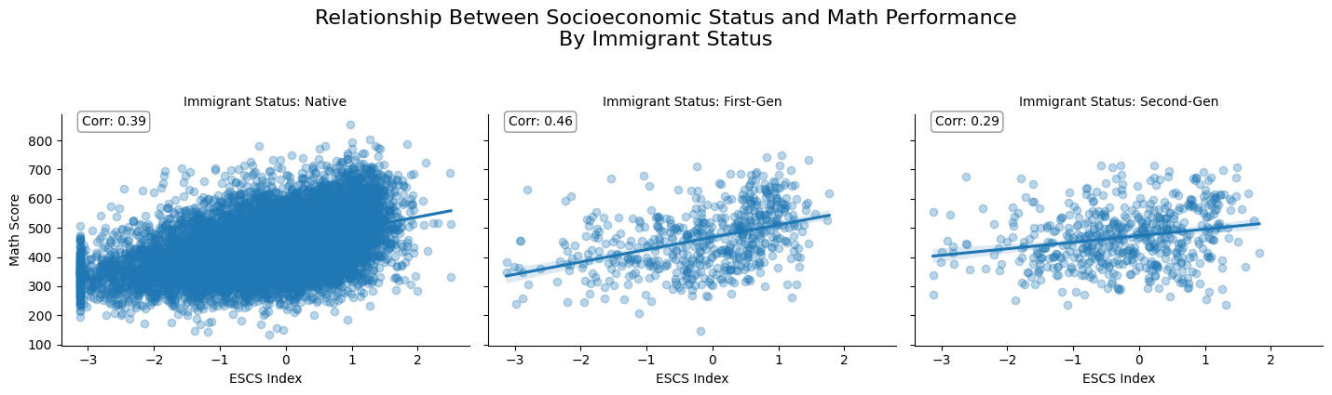
Socioeconomic Impact
Observations:
Positive correlation between country-level socioeconomic status and performance
Notable outliers perform better or worse than their ESCS would predict
Some education systems achieve strong results despite modest resources

Slide 11

School Climate Factors
Key Relationships:
Positive disciplinary climate correlates with better performance
Quality of teacher-student relationships shows positive impact
Student sense of belonging varies across countries but generally maintains positive relationship with outcomes

Slide 12
Country Performance Patterns
East Asian Excellence:
Singapore, China, Japan, and Korea lead in mathematics and science
Scores typically 30-50 points above OECD average
European Strong Performers:
Estonia and Finland combine high performance with educational equity
Regional Patterns:
East Asian systems emphasize mathematics
Northern European systems show more balanced results
Several developing economies making significant progress

Slide 13


Policy Implications
Addressing Inequality:
Education systems can improve equity without sacrificing excellence
Gender-Responsive Approaches:
Targeted strategies needed to address persistent gender gaps
School Environment:
Investing in positive school climates provides substantial returns
System Design:
High-performing systems combine autonomy with accountability, strong teacher preparation, and support for disadvantaged schools

Slide 14


Conclusion
Excellence and Equity Can Coexist
Countries like Estonia demonstrate both high performance and equity
Context Matters
Cultural, socioeconomic, and policy factors all influence outcomes
Multiple Pathways to Success
Different approaches to education can yield strong results
Data-Informed Policy
International assessments provide valuable insights for education policy development and implementation

Slide 15
Thank You for the Attention

